Slide 1

Where Are The Drugs?
By Phillip Vargas

Slide 2
Background
Medicare is a national health insurance program in the United States, begun in 1966 under the Social Security Administration and now administered by the Centers for Medicare and Medicaid Services (CMS).
In 2014 the CMS had 1.2 billion claims for medication prescriptions.
In 2014 the census estimated the United States population to be 318 million people
Does population demographics effect medication prescriptions?

Slide 3
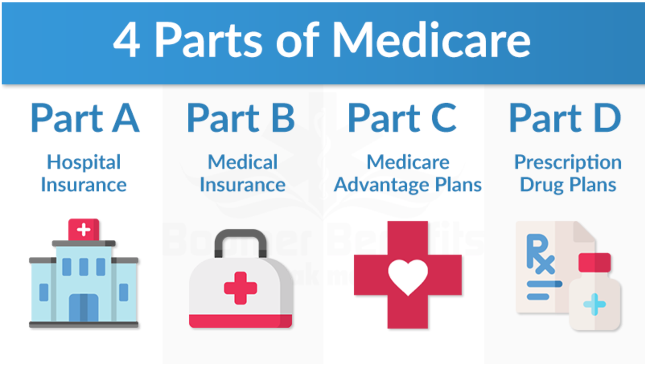

Slide 4
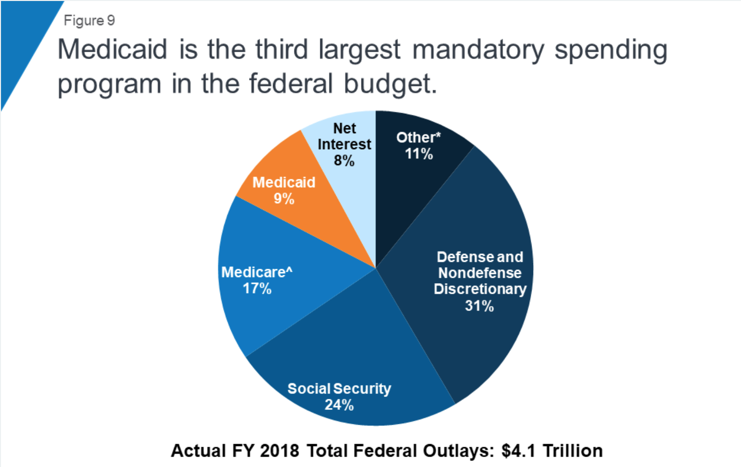
Motivation

Slide 5


SOURCES
Google Cloud Platform: Medications Table
https://console.cloud.google.com/bigquery?project=bold-lantern-272703&folder=&organizationId=&p=bigquery-public-data&d=cms_medicare&t=physicians_and_other_supplier_2015&page=table
Census.gov: Population Table
https://www.census.gov/data/tables/time-series/demo/popest/2010s-state-total.html#par_textimage_1574439295
Census.gov: Demographic Table
https://www.census.gov/data/tables/time-series/demo/popest/2010s-state-detail.html#par_textimage_785300169

Slide 6
DATA
Google Cloud Platform
23 Tables
200+ Features
9.5 million datapoints
Features of interest: State, Drug Name, Total Claims
Census.gov
2 tables
70+ Features
5k+ datapoints
Features of interest: State, Estimated Population Size, Gender, Race

Slide 7
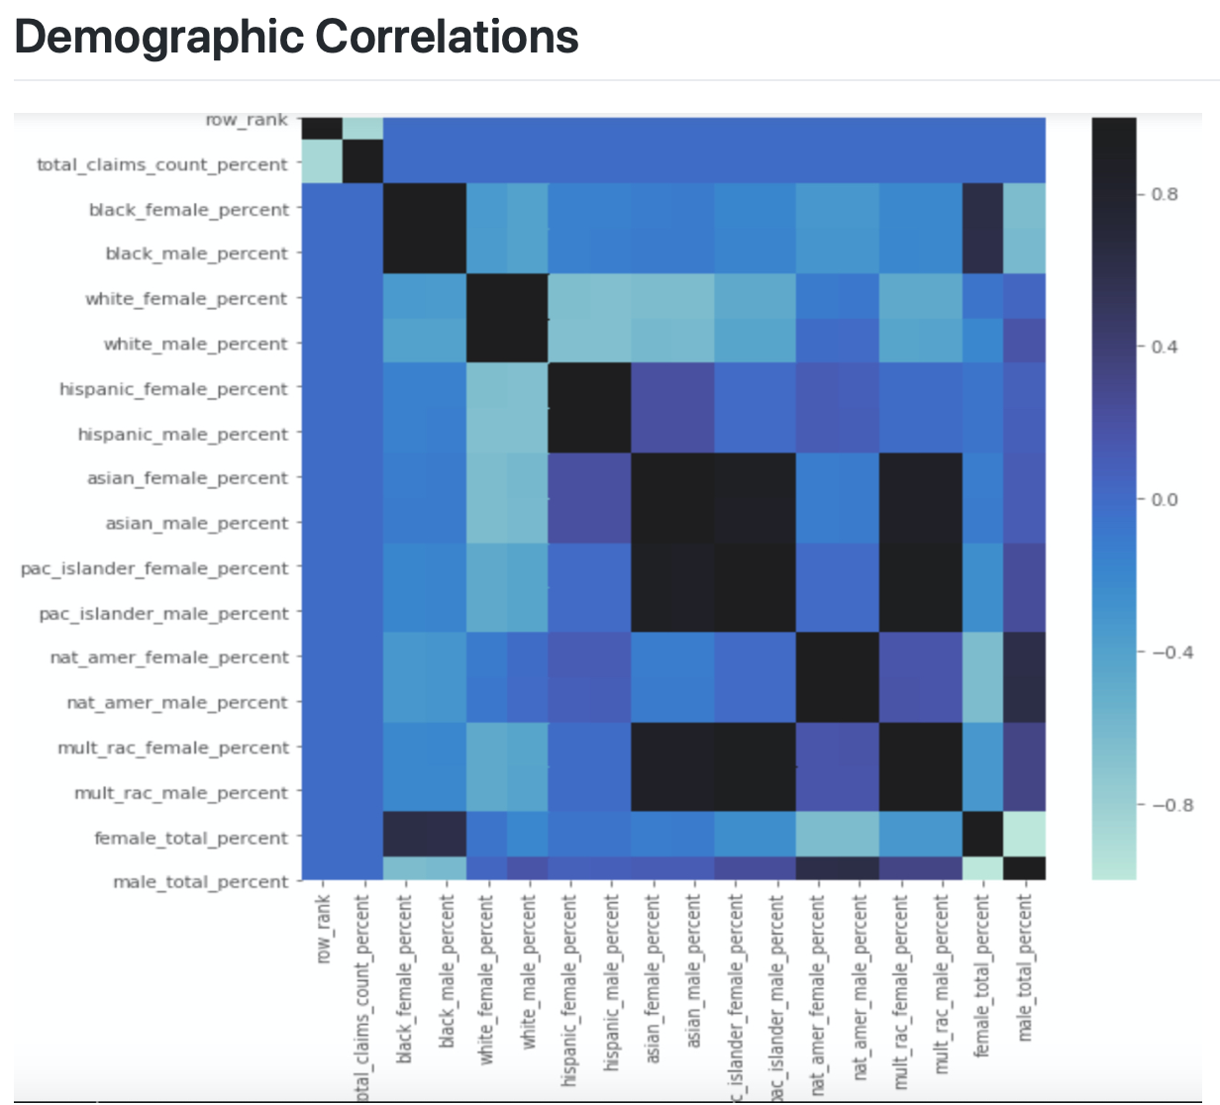
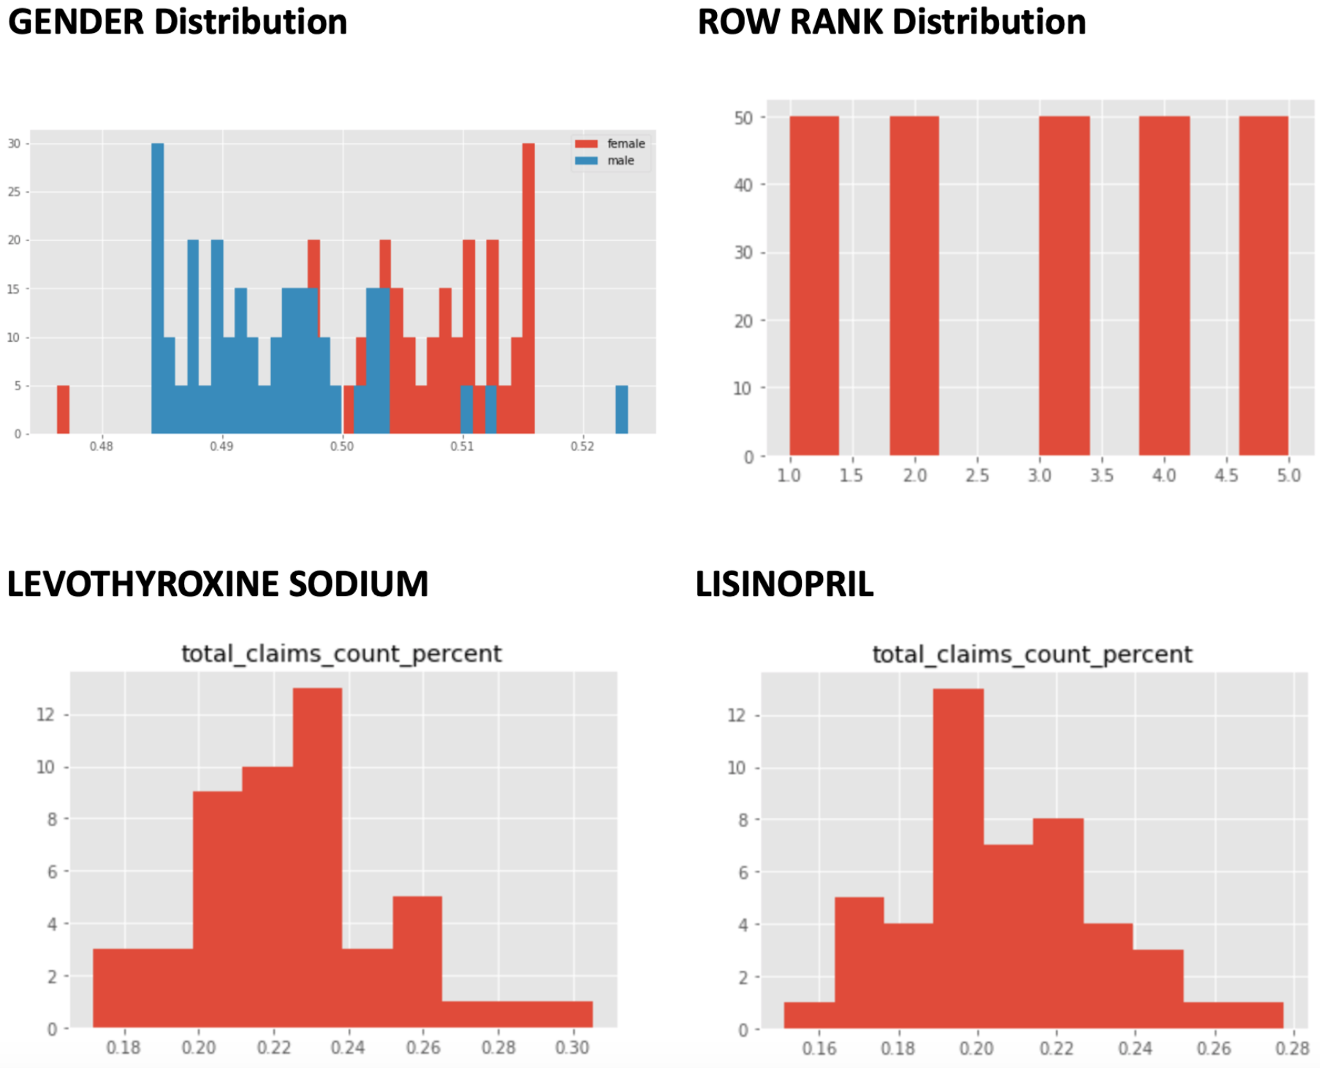
EDA

Slide 8
Create a Probabilistic Model of the Situation Assuming the Null Hypothesis is True
Drug of Focus:
LEVOTHYROXINE SODIUM
This treats hyperthyroidism
Demographic of Focus:
Gender population percentage
Drugs are ranked 1 to 5
5 being highest total claims in state
1 being lowest total claims in state
NULL: There is no correlation between LEVOTHYROXINE SODIUM and gender population percentage

Slide 9
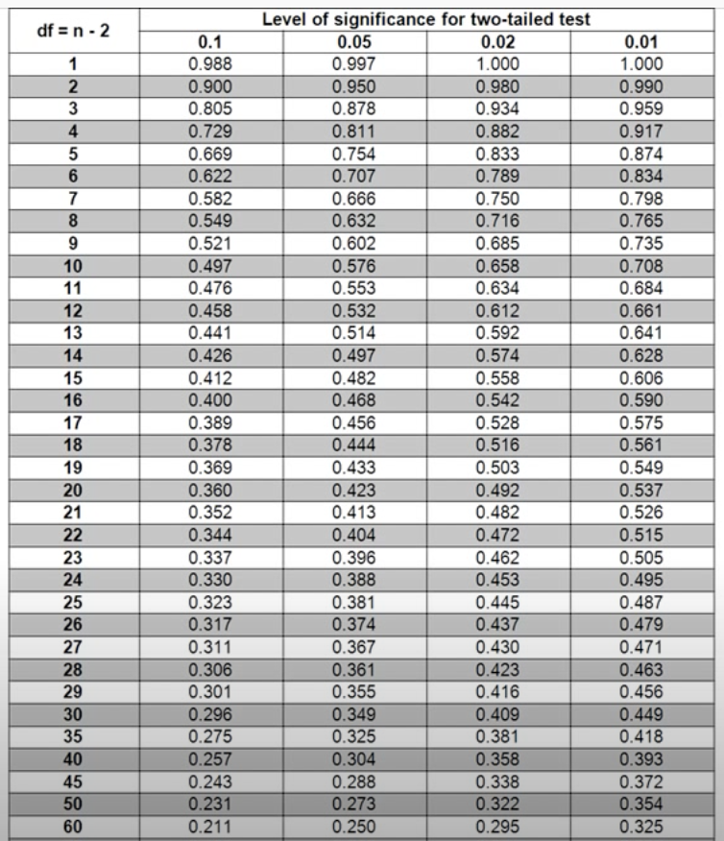
Decide how certain You Need to Be to Reject Your Skeptical Assumption
Choosing a 99% confidence interval
Alpha = .01

Slide 10
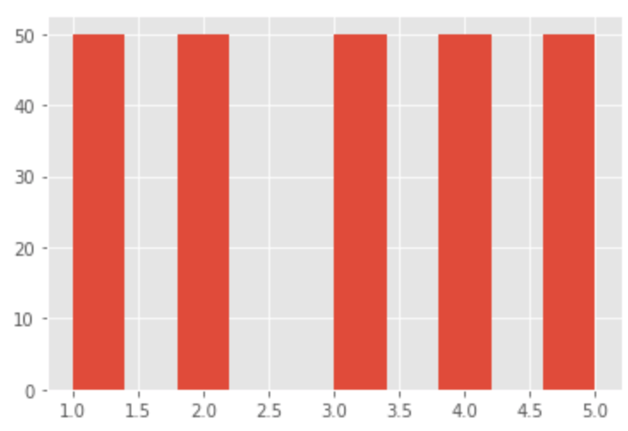
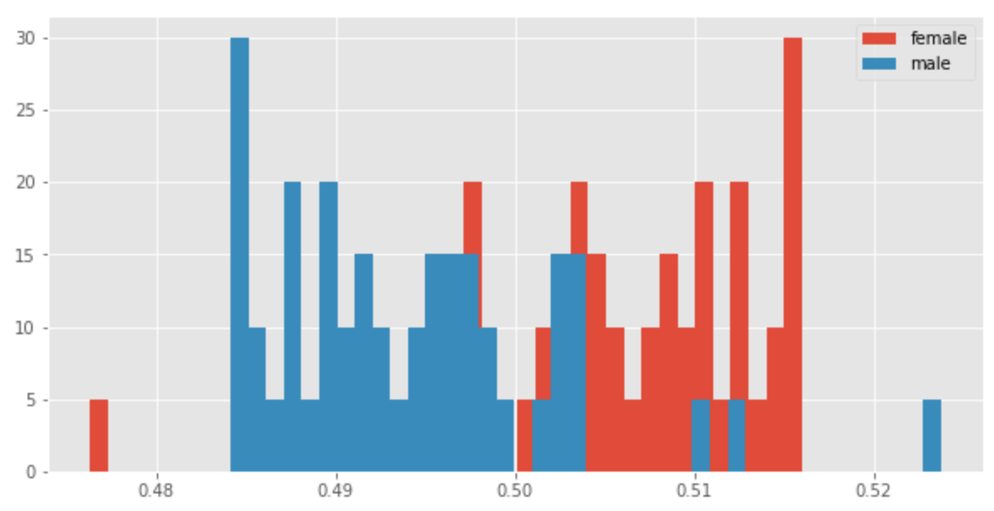
Collect Your Data
GENDER Distribution
ROW RANK Distribution

Slide 11
Calculate the Probability of Finding a Result Equally or More Extreme than Actually Observed
Spearman Correlation r-test
Define Null and Alternative Hypotheses
State Alpha
Calculate Degrees of Freedom
State Decision Rule
Calculate Test Statistic
State Results
State Conclusion
There is NO relationship between gender and drug rank for drug LEVOTHYROXINE SODIUM
Alpha = .01
DOF = 47-2= 45
If r > .372, then REJECT Null
r(45) = .433
r(45) = .433 > .372; REJECT NULL
There is a correlation with 99% CI
https://www.youtube.com/watch?v=rR-jptLvhFw

Slide 12
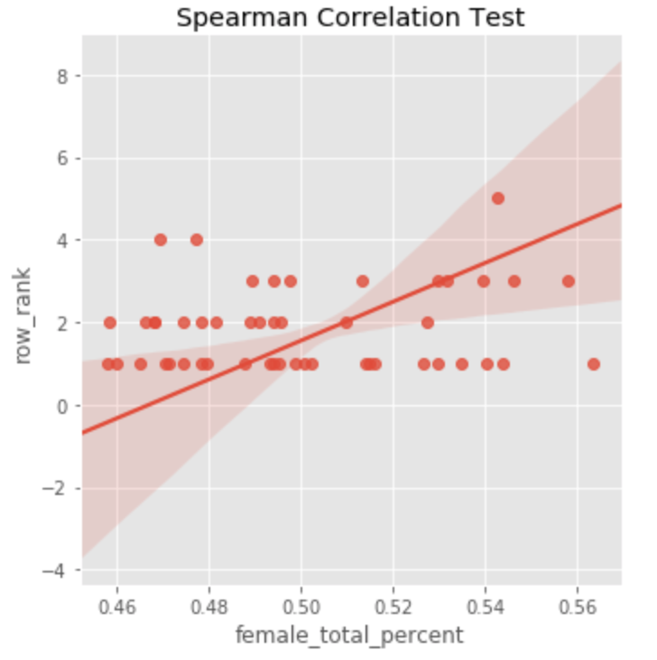
Lets view this test graphically

Slide 13

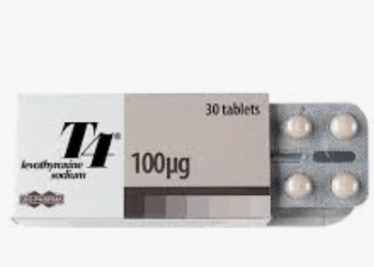
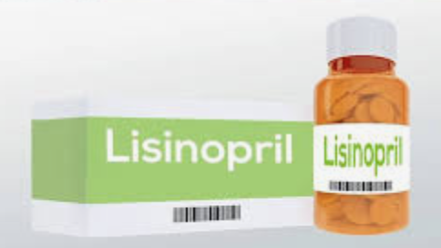
LETS COMPARE DRUGS!!
LEVOTHYROXINE SODIUM:
Treats Hyperthyroidism
LISINOPRIL:
Treats High Blood Pressure

Slide 14
Hypothesis Testing with Welch's t-test
Define Null and Alternative Hypotheses
State Alpha
State Decision Rule
Calculate Test Statistic
State Results
State Conclusion
There is NO significant difference in claims percentage between the drugs LEVOTHYROXINE SODIUM and LISINOPRIL
Alpha = .01
If pval < alpha, then REJECT Null
pval = .0007
pval = .0007 < .01; REJECT NULL
With a 99% CI There is a significant difference
https://www.youtube.com/watch?v=rR-jptLvhFw

Slide 15
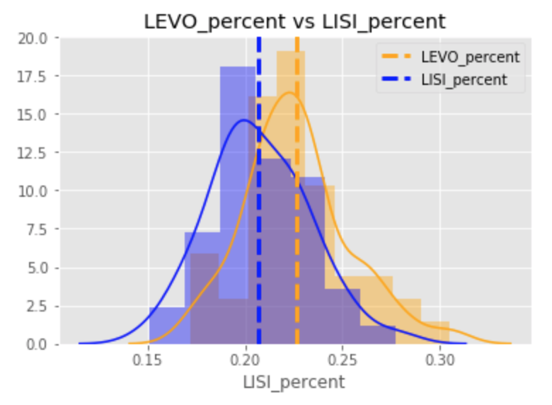

Slide 16
Conclusion and next steps
I learned there are correlations between population demographics drug prescriptions.
I also discovered hyperthyroidism had the most claims for drug prescriptions in Medicare.
A huge take away from me is DON’T MAKE ASSUMPTIONS. I assumed gender would be normally distributed in this dataset and it was not.
ADVICE: Understand which tools are used for which problems even if you don’t fully know how to use the tool.
I am on the fence about keeping topic!

